Slide 1
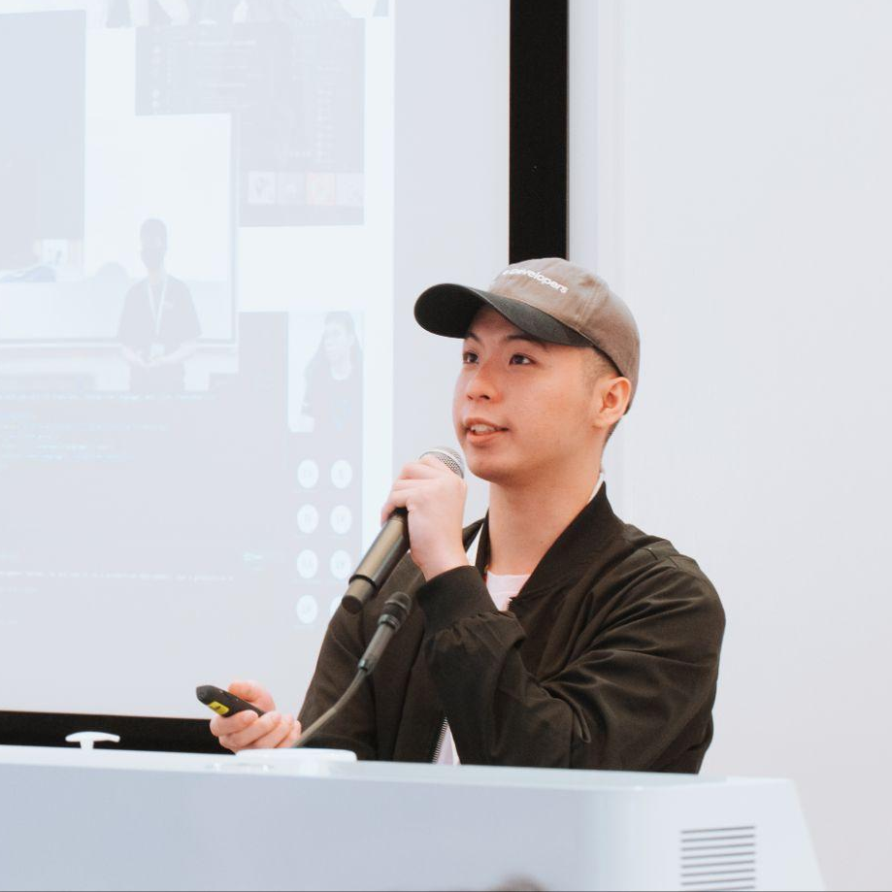


Workshop:
Build & Deploy Simple Resume Website
Kai Yong Lai Software Engineer, Farmz Asia

Slide 2
Web Development
Essentials

Slide 3

HTML

Slide 4

CSS

Slide 5

JavaScript

Slide 6
Workshop
Prerequisites

Slide 7


Tools
Visual Studio Code (VSCode)
Github Account

Slide 8




Hands-on Now!
Laikaiyong
Kai Yong Lai (Vandyck)
@vandyck.lai

